Slide 1
Arduino Session 14
UART Protocol

Slide 2
What is Universal Asynchronous Receiver-Transmitter Protocol
Serial communication
peer-to-peer protocol (supports only two nodes, except a custom version in circular network)
Asynchronous communication
Basic Data Framing
No Addressing
Managed by a dedicated device inside the microcontroller

Slide 3
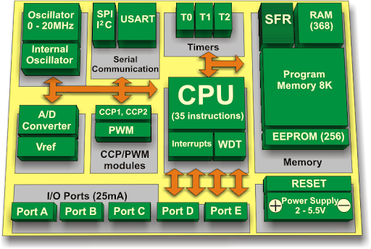
How to control the UART device
Arduino UART Library is way more robust compared to SPI, we don’t need to know register.
Search online for how to use the UART device with Serial monitor

